Slide 1

DeepCheckers
Cem Güleç - 150117828
Büşra Gökmen - 150116027
Muhammet Şeramet - 150115069
Supervised by
Asst. Prof. Mehmet Kadir Baran

Slide 2

Outline
1
Problem Description and Motivation
Project Aims
Related Work
Scope
Methodology and Technical Approach (Bitboards, Neural Net, MCTS)
Tasks Accomplished
Diﬃculties Encountered
Task to be completed in the second semester (nn-improvements,api, test)

Slide 3
Problem Description
2
Deep Learning has become a pioneer method
Solution proposal for complex problems
The first step solving problems: Games
Traditional Games(Chess and Go) vs Checkers

Slide 4
What are we doing?
Different strategies
Unsupervised vs Supervised (lack of sufficient resources, the cost of creating new resources, the reliability of the data)
AI player that can master any game and apply on Turkish Checkers
3
Motivation
No researches on the same topic
Inspire new researches
Games on our social life

Slide 5
Project Aims
4
AI models (agents) that can learn and play Turkish checkers, which is a traditional board game, with the help of deep learning-based techniques.
Implementing Game
Implementing Game Tree
Implementing Neural Network
Designing API (maybe)
Evaluating Model based on scoring system at Turkish Draughts Federation (maybe)

Slide 6
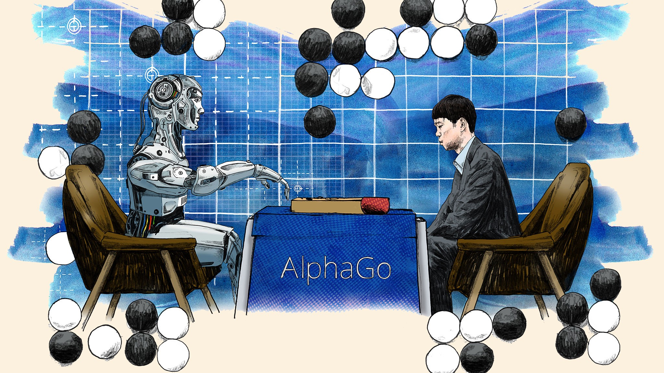
Related Work
5
Figure 1: Image representing match between Lee Sedol and AlphaGo.

Slide 7
Related Work
6
Related works throughout history
What methods they applied?
Which other areas these are also applied to?
Any novelties done?

Slide 8
Scope
7
Learn to play checkers game without preliminary information/rules
Training time depends on computer’s processing power.
System should provide an output within a given period of time. For example, it should output at a minimum of responding threshold time.
The output of the system should be reasonable.
It is assumed that the end model will be accurate. In a given game state, model will play the most promising move.

Slide 9
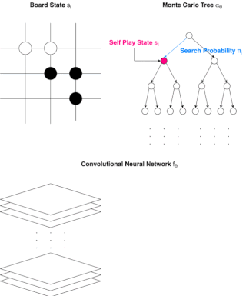
Methodology: General Introduction
8
Board state
Training Neural Network via self play
Connection between MCTS (unvisited node) and Neural Network
Making move
Figure 2: General implementation of our methods

Slide 10
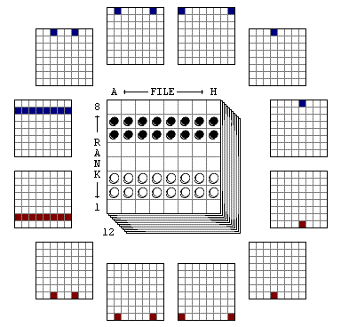
Methodology: Bitboards
9
Represents board
Finite sets - 64 elements
White/Black Pawns and Kings array
Pros:
-> Ease of making a move (Bitwise op.)
-> Efficient memory usage
Cons:
-> Long code (Hard to debug)
Figure 3: Bitboard representation for Checkers board

Slide 11
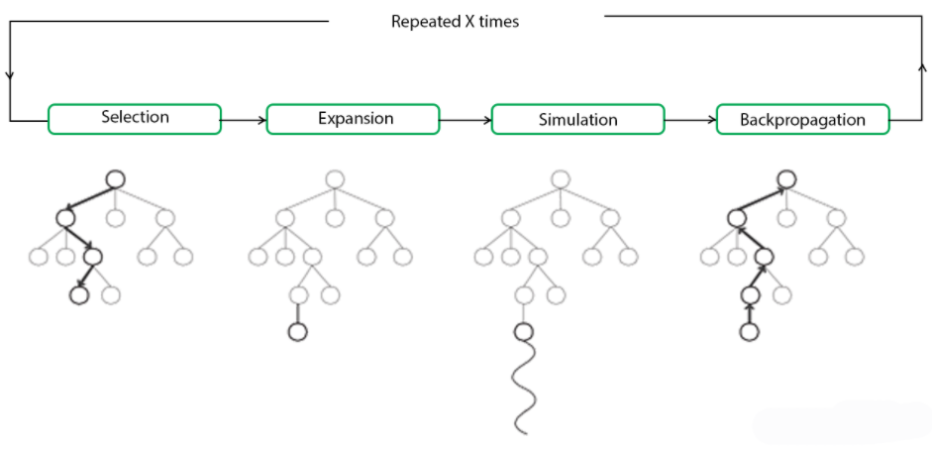
Methodology: Monte Carlo Tree Search
10
Figure 4: Monte Carlo Tree Search processes

Slide 12
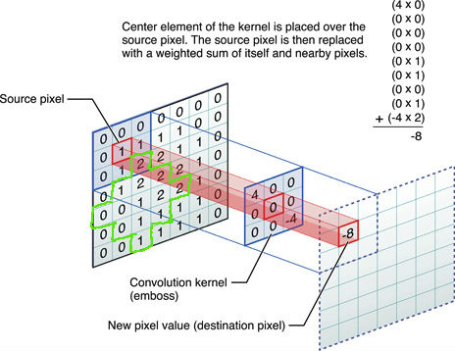
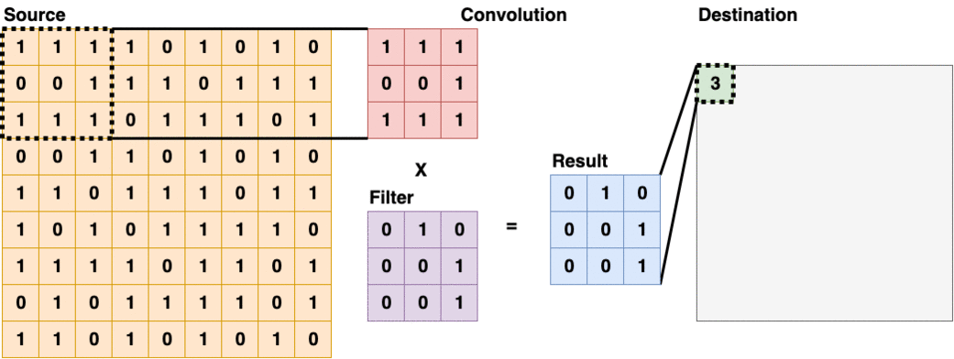
Methodology: Neural Network Approach (CNN)
11
Convolutional Layer usually appears as the first layer of a Convolutional Neural Network. These types of layers will scan through the source layer with a filter, and put the sum of values into the destination layer. Some filters are good at detecting edges and some are good in other tasks.
Figure 5: Representation of convolution process
Figure 6: Representation of Layer and Filter

Slide 13
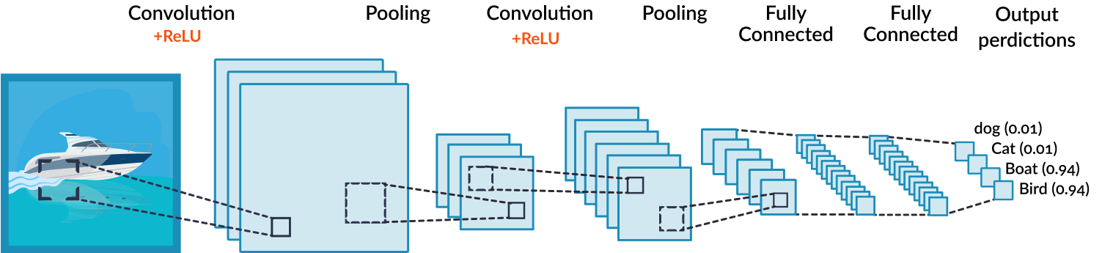
Methodology: Neural Network Approach (CNN)
12
Network Architecture
Usage of Convolutional Neural Network
Figure 7: Convolutional Neural Network Architecture

Slide 14
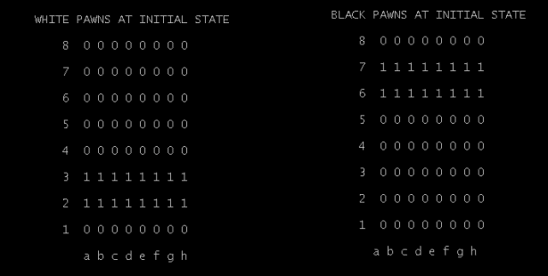
Tasks Accomplished
13
Implementation of Board -> array representation -> bitboard representation
Implementation of MCTS (connecting game)
Neural Network Sample
Figure 8: Initial states for the White and Black Pawns

Slide 15
Difﬁculties Encountered
14
Structuring concrete connection between these concepts
Resource problem (for the Turkish checkers)
There is no practical checkers project, even if we can base it on mathematical articles to some extent.

Slide 16
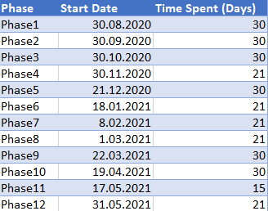
Task to be completed in second semester
15
Neural Network Improvements:
-> hyper parameters
-> loss
-> optimizer
-> model architecture
Implementing API for connecting model to real world gaming platforms
Testing
B Plan

Slide 17
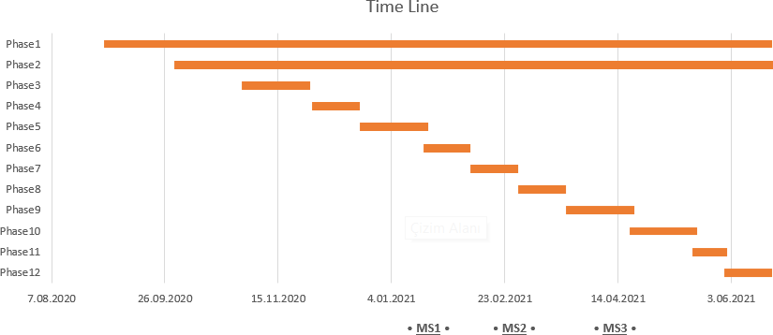
Timeline for the second semester
16
MS1: Connecting neural network and game structure code
MS2: Starting to improve our initial basis
MS3: Starting to improve our neural network and gameplay structure

Slide 18
References
17
[1] Schaeffer, Jonathan & Björnsson, Yngvi & Kishimoto, Akihiro & Müller, Martin & Lake, Robert & Lu, Paul & Sutphen, Steve. (2007). Checkers Is Solved. Science. 317. 1518-1522. 10.1126/science.1144079.
[2] Murray Campbell, A.Joseph Hoane, Feng-hsiung Hsu, “Deep Blue”, Artificial Intelligence, Volume 134, Issues 1–2, 2002.
[3] Sylvain Gelly, David Silver, Monte-Carlo tree search and rapid action value estimation in computer Go, 2011.
[4] Silver, D., Huang, A., Maddison, C. et al. Mastering the game of Go with deep neural networks and tree search. Nature 529, 484–489 (2016).

Slide 19
Thank you for listening!
Any questions?

